Slide 1

Modeling Strategies Random forest using H20 and Undersampling and oversampling
Varadharajan Suresh
vs2769

Slide 2


PART -1 Using Select features and engineered features

Slide 3
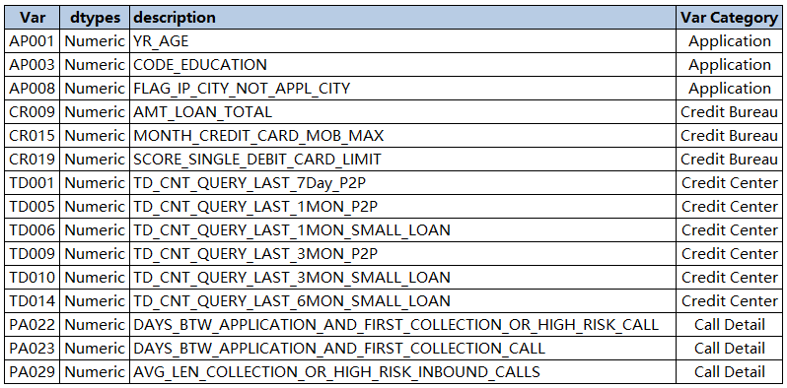
EDA
Data Dictionary
Newly created features
AP001_D_WOE, AP003_D_WOE, AP008_D_WOE, CR009_D_WOE, CR015_D_WOE,CR019_D_WOE, PA022_D_WOE, PA023_D_WOE, PA029_D_WOE,TD001_D_WOE, TD005_D_WOE, TD006_D_WOE, TD009_D_WOE,TD010_D_WOE, TD014_D_WOE

Slide 4
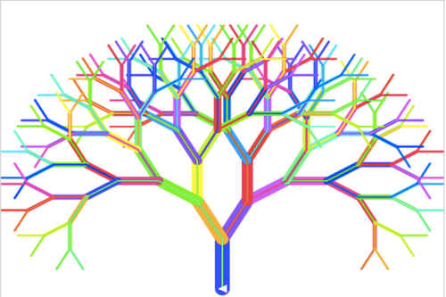
Modelling
H2O is an opensource machine learning platform that facilitates you to build models based on data that you have.
What is Random Forest?
Random forest is a technique used in modeling predictions and behavior analysis and is built on decision trees. It contains many decision trees representing a distinct instance of the classification of data input into the random forest. The random forest technique considers the instances individually, taking the one with the majority of votes as the selected prediction.

Slide 5
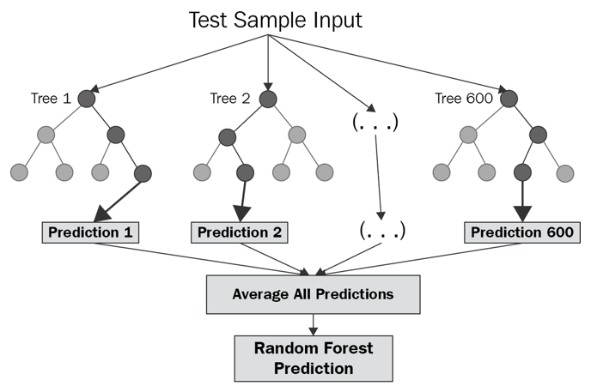
Modelling
H2O is an opensource machine learning platform that facilitates you to build models based on data that you have.
rf_v1 = H2ORandomForestEstimator(
model_id = rf_v1,
ntrees = 300,
nfolds=10,
min_rows=100,
seed=1234)
model_id: The unique id assigned to the resulting model. If none is given, an id will automatically be generated.
Ntrees: A non-negative integer that determines the number of trees to grow.
Nfolds: Number of folds for cross-validation. If nfolds >= 2, then validation must remain empty.
min_rows: Minimum number of rows to assign to terminal nodes.
Seed: Seed for random numbers (affects sampling) - Note: only reproducible when running single threaded

Slide 6
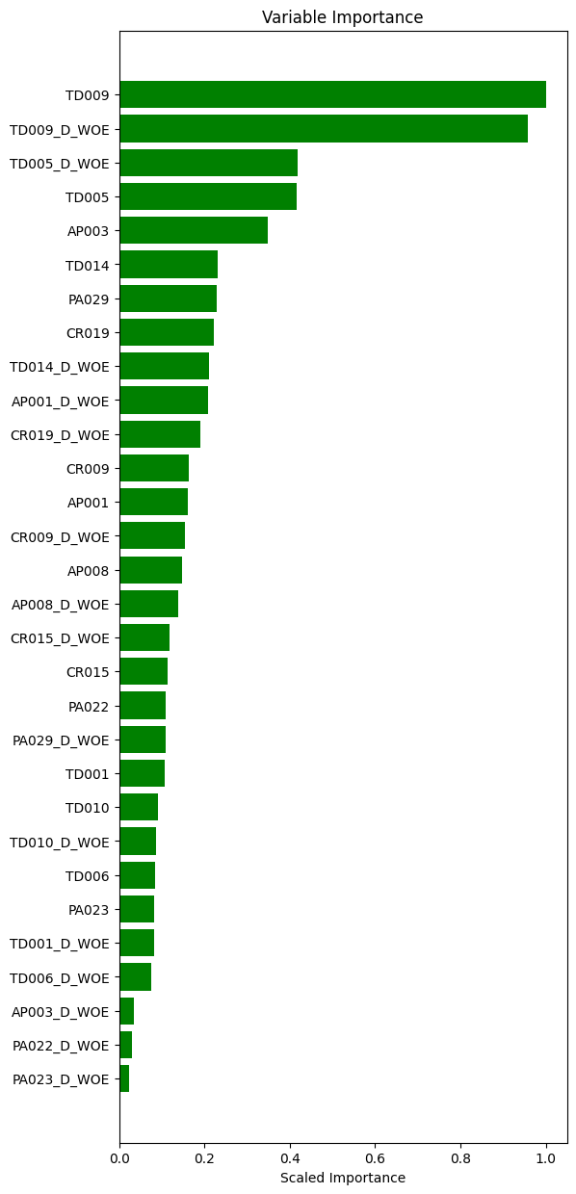
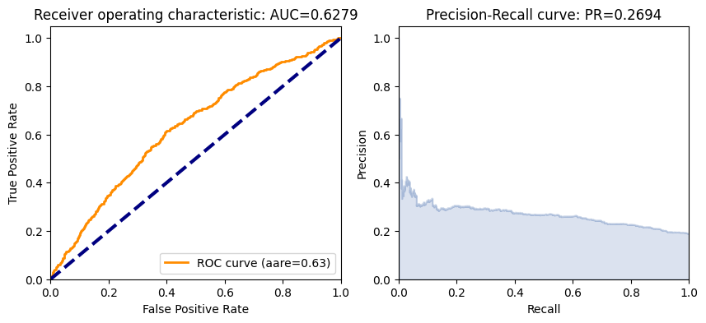
RF Model -1
Feature Importance
Using sample size, 10% of original size
rf_v1 = H2ORandomForestEstimator(
model_id = rf_v1,
ntrees = 300,
nfolds=10,
min_rows=100,
seed=1234)

Slide 7
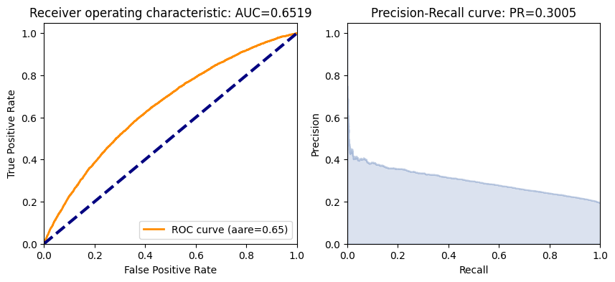
RF Model - 2
Using the entire data set
rf_v2 = H2ORandomForestEstimator(
model_id = rf_v2,
ntrees = 300,
nfolds=10,
min_rows=100,
seed=1234)

Slide 8

RF Model - 3
After removing features post feature importance evaluation, with a threshold of 0.10.
Predictors Used:
TD009, TD009_D_WOE, TD005_D_WOE, TD005, AP003, TD014, PA029, CR019, TD014_D_WOE, AP001_D_WOE, CR019_D_WOE, CR009, AP001, CR009_D_WOE, AP008, AP008_D_WOE, CR015_D_WOE, CR015, PA022, PA029_D_WOE, TD001

Slide 9

RF Model - 4
Using Random Undersampling
A simple under-sampling technique is to under-sample the majority class randomly and uniformly. This can potentially lead to loss of information. But if the examples of the majority class are near to others, this method might yield good results.

Slide 10
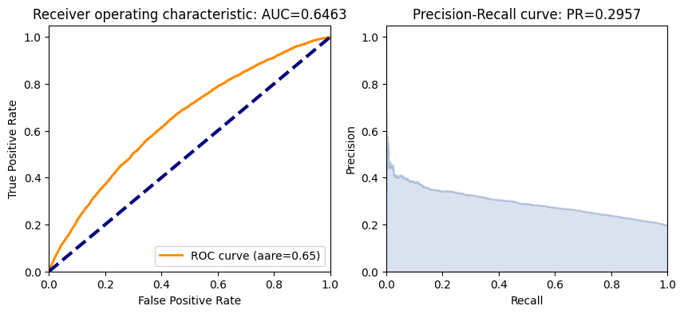
RF Model - 5
Neighborhood Cleaning Rule
Neighborhood Cleaning Rule modifies the Edited Nearest Neighbor method by increasing the role of data cleaning. Firstly, NCL removes negatives examples which are misclassified by their 3-nearest neighbors. Secondly, the neighbors of each positive examples are found and the ones belonging to the majority class are removed.

Slide 11

RF Model - 6
Random oversampling for the minority class
Random oversampling simply replicates randomly the minority class examples. Random oversampling is known to increase the likelihood of occurring overfitting. On the other hand, the major drawback of Random undersampling is that this method can discard useful data.

Slide 12
PART -2 using raw features

Slide 13
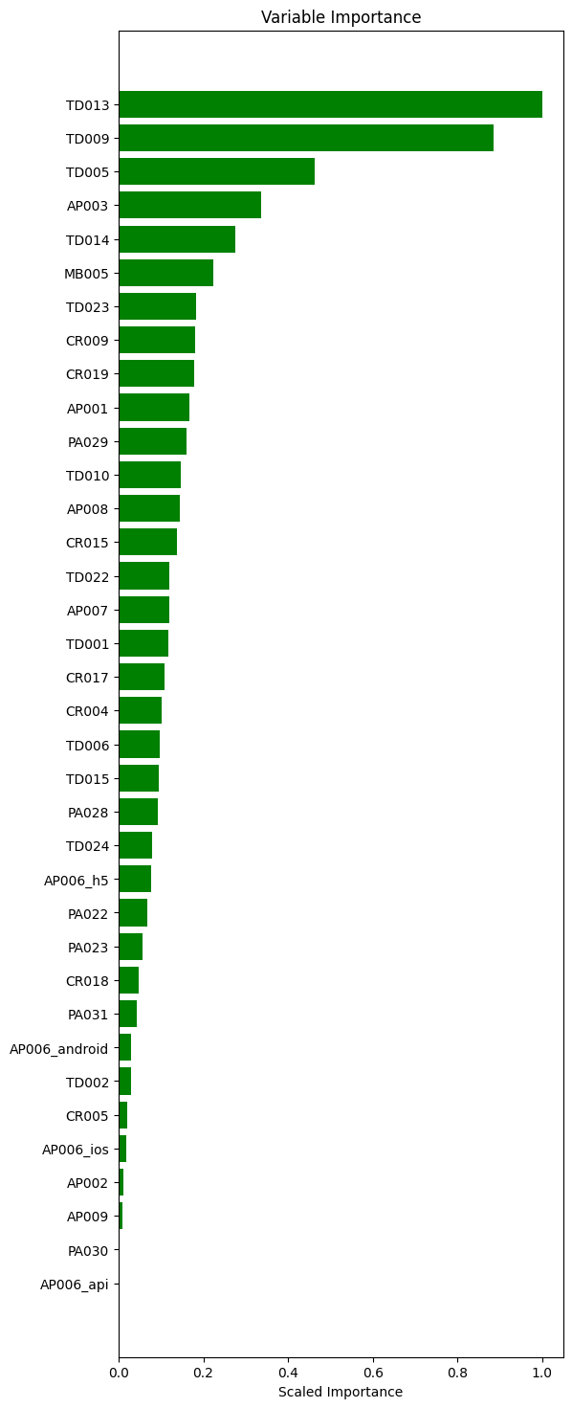
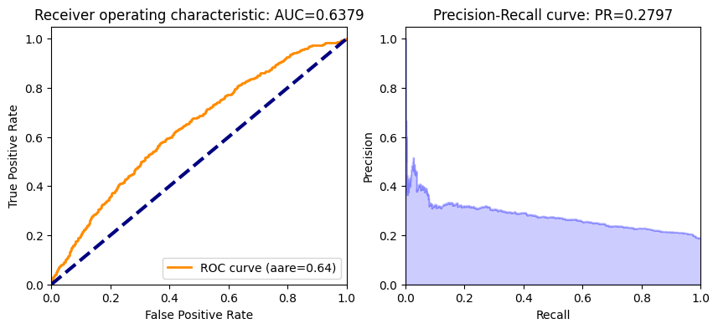
RF Model -1
Feature Importance
Using sample size, 10% of original size
rf_v1 = H2ORandomForestEstimator(
model_id = rf_v1,
ntrees = 300,
nfolds=10,
min_rows=100,
seed=1234)

Slide 14
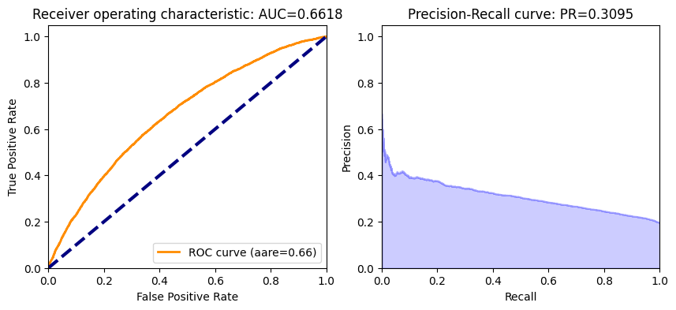
RF Model - 2
Using the entire data set
rf_v2 = H2ORandomForestEstimator(
model_id = rf_v2,
ntrees = 300,
nfolds=10,
min_rows=100,
seed=1234)

Slide 15
RF Model - 3
After removing features post feature importance evaluation, with a threshold of 0.10. and using only numeric features
Predictors Used:
TD013, TD009, TD005, AP003, TD014, MB005, TD023, CR009, CR019, AP001, PA029, TD010, AP008, CR015, TD022, AP007, TD001, CR017, CR004

Slide 16

RF Model - 4
After removing features post feature importance evaluation, with a threshold of 0.10. and including categorical variables
Predictors Used:
TD013,AP006_android,AP006_api,AP006_h5,AP006_ios, TD009, TD005, AP003, TD014, MB005, TD023, CR009, CR019, AP001, PA029, TD010, AP008, CR015, TD022, AP007, TD001, CR017, CR004

Slide 17
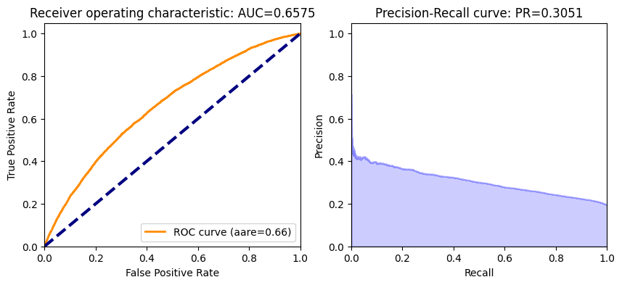

RF Model – 5 & 6
rf_v5 = H2ORandomForestEstimator(
model_id = 'rf_v5',
ntrees = 300,
max_depth = 20,
nfolds=10,
min_rows=200,
seed=1234)
rf_v6 = H2ORandomForestEstimator(
model_id = 'rf_v6',
ntrees = 48,
nfolds=10,
min_rows=100,
max_depth = 10,
balance_classes = True,
seed=1234)

Slide 18
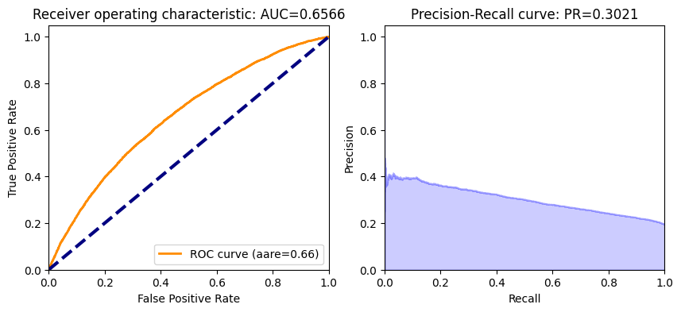
RF Model - 7
Using Random Undersampling
A simple under-sampling technique is to under-sample the majority class randomly and uniformly. This can potentially lead to loss of information. But if the examples of the majority class are near to others, this method might yield good results.

Slide 19
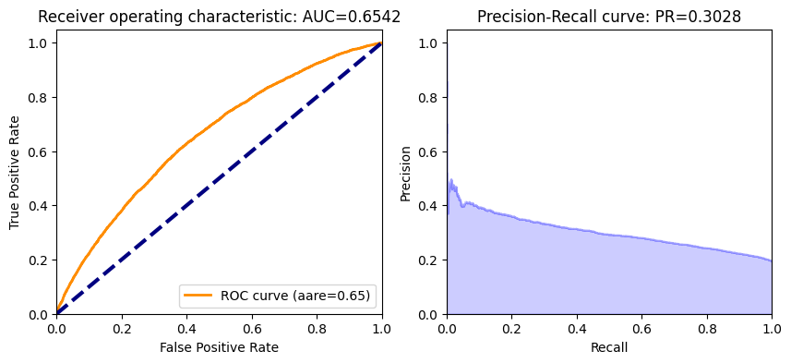
RF Model - 8
Neighborhood Cleaning Rule
Neighborhood Cleaning Rule modifies the Edited Nearest Neighbor method by increasing the role of data cleaning. Firstly, NCL removes negatives examples which are misclassified by their 3-nearest neighbors. Secondly, the neighbors of each positive examples are found and the ones belonging to the majority class are removed.

Slide 20

RF Model - 9
Random oversampling for the minority class
Random oversampling simply replicates randomly the minority class examples. Random oversampling is known to increase the likelihood of occurring overfitting. On the other hand, the major drawback of Random undersampling is that this method can discard useful data.

Slide 21


Thank you

